Slide 1
Coursera_Capstone Project Week -5
PROJECT REPORT
INDIAN RESTRAUNTS IN TORONTO , CANADA

Slide 2
INTRODUCTION
A hypothetical scenario for a concept that there may not be enough Indian Restaurants in Toronto Area.
Therefore it might be a great opportunity for an entrepreneur who is based in Canada.
As the Indian food is popular among Asian community, so this entrepreneur might think of opening its business in areas where Asian community resides.
Finding the location to open such a restaurant is one of the most important decisions for an entrepreneur.
This project will help him find the most suitable location.

Slide 3
BUSINESS PROBLEM
To find the most suitable location for the entrepreneur to open a new Indian Restaurant in Toronto,Canada.

Slide 4
TARGET AUDIENCE
The entrepreneur who wants to find the location to open authentic Indian restaurant.

Slide 5
DATA
To solve this problem, we will need below data:
● List of neighbourhoods in Toronto, Canada
● Latitude and Longitude of these neighborhoods
● Venue data related to Indian restaurants. This will help us find the neighborhoods that are more suitable to open an Indian Restaurant.

Slide 6
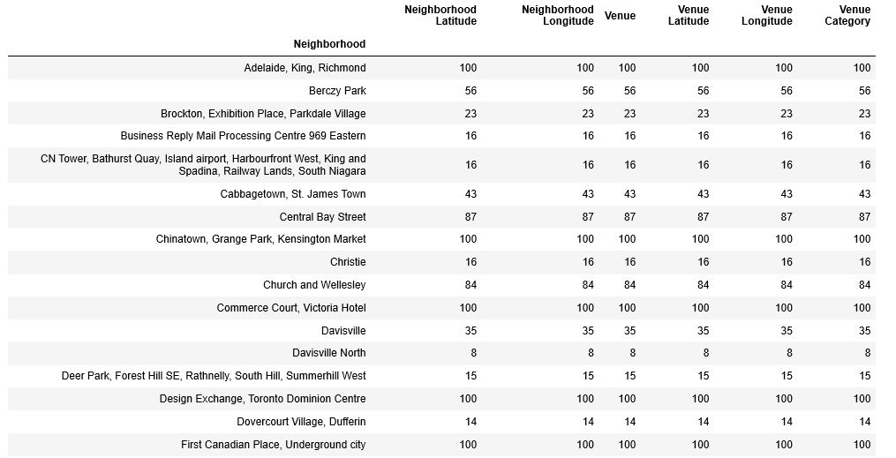

Slide 7
EXTRACTING THE DATA
● The scrapping of Toronto neighborhoods via Wikipedia
● Getting Latitude and Longitude data of these neighborhoods via Geocoder package
● Using Foursquare API to get venue data related to these neighborhoods

Slide 8
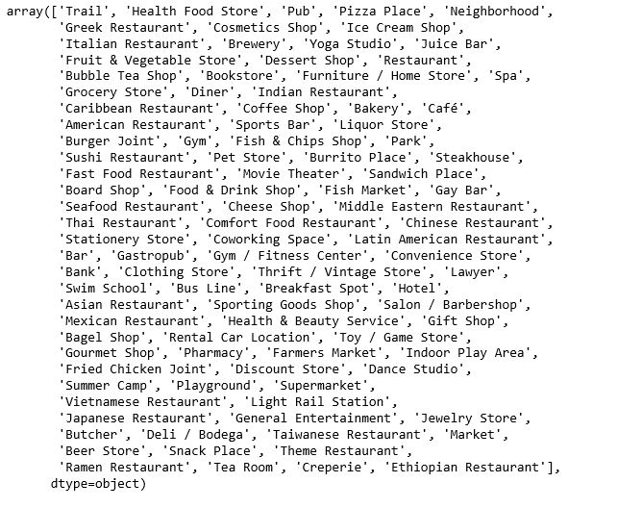

Slide 9
RESULT - CLUSTERS
● Cluster 0: Neighborhoods with the less number of Indian
restaurants.
● Cluster 1: Neighborhoods with no Indian restaurants.
● Cluster 2: Neighborhoods with a more number of Indian restaurants

Slide 10
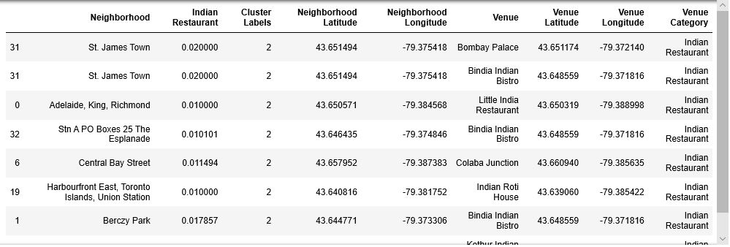

Slide 11
RECOMMENDATIONS
Most of the Indian restaurants are in cluster 2 which is around Central Bay Street, Church and Wellesley, Berczy Park, Union Station, Richmond, lowest in Cluster 1 areas which are in North Toronto West and Parkade areas.

Slide 12
THANK YOU !

